Slide 1

Initiating Evaluations for the Digital Education Ecosystem Project
Done By: Ashok & Sankalp
Guides: Dr. Conrad Gleber, Alex Clark

Slide 2
Data Process
(Runs Weekly)
Pull Data Via Clarity
Put Data Into Database
Join Data
Trigger Evaluation
Check dyad table to find new dyads.
Pull Data Via MedHub
Check for Missing Supervisors/Learners
Audit Data
POST to MedHub API with new data

Slide 3
Data Pulls
Data Team
Student
MedHub API
Clarity
Python Scripts
Clarity Dyad
Note by Learner
Attested by Supervisor
Faculty
userID
email
username
Program
programID program_name program_abbrev program_level dept_programID
Resident userID
email
username
employeeID
typeID
level
programID
Resident Types
userType
typeName
Evaluations
evaluationID
evaluation_title
introduction
questions_count
types
Evaluation Types
typeID
Type_name
Dyads
NewID
Program ID
Dyad Type (Eval or Procedure)
Learner Prov ID
Learner Prov Name
Supervisor Prov ID
Supervisor Prov Name
Supervisor Email Address
Learner Email Address
DTTM
Evaluation Responses
evaluationID
eval_type
evaluatee_userID
Evaluator_userID

Slide 4
Student
KEY:
Via Clarity
Created in DB
Via MedHub API
Database Structure
Unique Records (Used for Auditing/Updating MH)
Anti-Join to find supervisors in Clarity but not in MedHub
dbo.mh_faculty
userID
email
username
dbo.dyads
NewID
Program ID
Dyad Type (Eval or Procedure)
Learner Prov ID
Learner Prov Name
Supervisor Prov ID
Supervisor Prov Name
Supervisor Email Address
Learner Email Address
DTTM
vw.clarity_supervisor
Supervisor ID
Program ID
Supervisor Prov ID
Supervisor Prov Name
Supervisor Email Address
vw.missing_supervisors
Supervisor First Name
Supervisor Last Name
Supervisor Email Address
Supervisor username
vw.missing_learner
Learner First Name
Learner Last Name
Learner Email Address
Learner username
dbo.mh_resident
userID
email
username
employeeID
typeID
level
programID
vw.clarity_learner
LearnerID
Program ID
Learner Prov ID
Learner Prov Name
Learner Email Address
dbo.mh_evaluation_responses
Initiatiedevalid
responseID = evaluationID
Does not get joined, separate process to find responses as they come in.
vw.dyads_evaluation
NewID
Program ID
Dyad Type (Eval or Procedure)
Learner Prov ID
Learner Prov Name
Supervisor Prov ID
Supervisor Prov Name
Supervisor Email Address
Learner Email Address
DTTM
evaluationID
evaluation_title
introduction
questions_count
types
evaluatee_userID
Evaluator_userID
Type_name
dbo.mh_evaluations
evaluationID = evaluationformID
evaluation_title
introduction
questions_count
types
dbo.mh_user_types
userType
typeName
dbo.initiatied_eval
evaluationformID
Initiatiedevalid (incremental)
ProgramID
types
evaluatee_userID
Evaluator_userID
dbo.mh_evaluation_types
typeID
Type_name

Slide 5
Addition to Dyads
After mh_evaluations and mh_evaluations_responses have been joined, we can use that information to join in dyads
dbo.mh_faculty
userID
email
username
dbo.mh_resident
userID
email
username
employeeID
typeID
level
programID
dbo.joined_eval_dyad
evaluationformID
Initiatiedevalid (incremental)
types
evaluation_title
introduction
questions_count
evaluatee_userID
Evaluator_userID
Evaltype
NewID
Program ID
Dyad Type (Eval or Procedure)
Learner Prov ID
Learner Prov Name
Supervisor Prov ID
Supervisor Prov Name
Supervisor Email Address
Learner Email Address
DTTM
dbo.initiated_eval
evaluationformID
Initiatiedevalid (incremental)
types
evaluation_title
introduction
questions_count
evaluatee_userID
Evaluator_userID
Evaltype
Join dbo.new_table.evaluate_userID = dbo.mh_resident.userID Join dbo.new_table.evaluator_userID = dbo.mh_faculty.userID
Join dbo.dyads.supervisor_email_address= dbo.add_in_user_info.evaluator_email_address Join dbo.dyads.learner_email_address= dbo.add_in_user_info.evaluatee_email_address
dbo.add_in_user_info
evaluationformID
Initiatiedevalid (incremental)
types
evaluation_title
introduction
questions_count
evaluatee_userID
Evaluator_userID
Evaltype
Resident_email_address = evaluate_email_address
Faculy_email_address = evaluator_email_address
dbo.dyads
NewID
Program ID
Dyad Type (Eval or Procedure)
Learner Prov ID
Learner Prov Name
Supervisor Prov ID
Supervisor Prov Name
Supervisor Email Address
Learner Email Address
DTTM

Slide 6
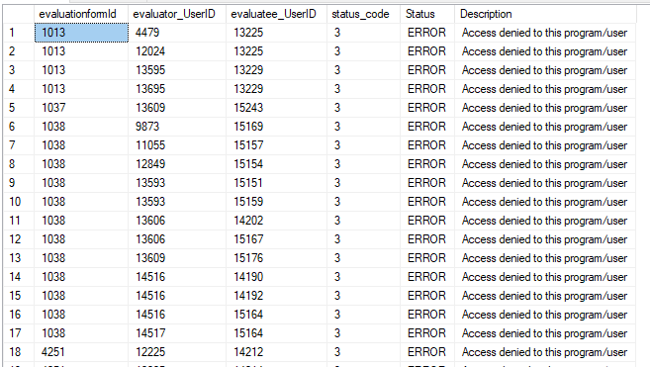
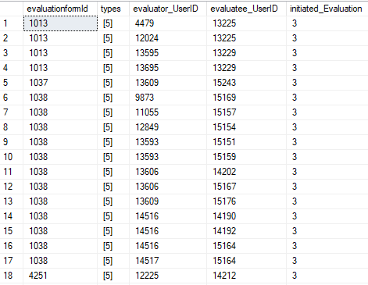
Results
Audit Table
Final Dyad Table

Slide 7
THANK YOU!

